Slide 1


Training the Trainers
Ride Safe
Trainer Award

Slide 2
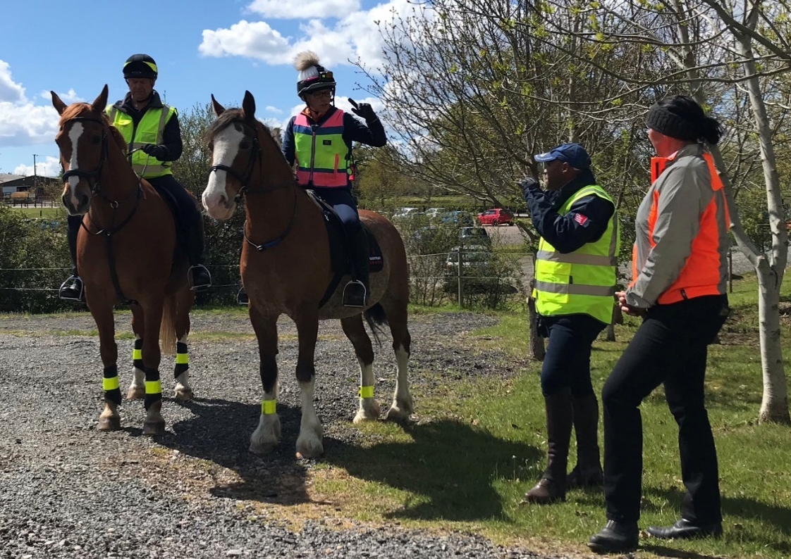

What is it?
A new qualification that supports coaches in the delivery of training and assessing the Ride Safe Silver Challenge Award.
It is envisaged that this will be a compulsory pre-requisite for Stage 3 Teach.
Training support delivered by YOU – our Ride Safe Advisors

Slide 3
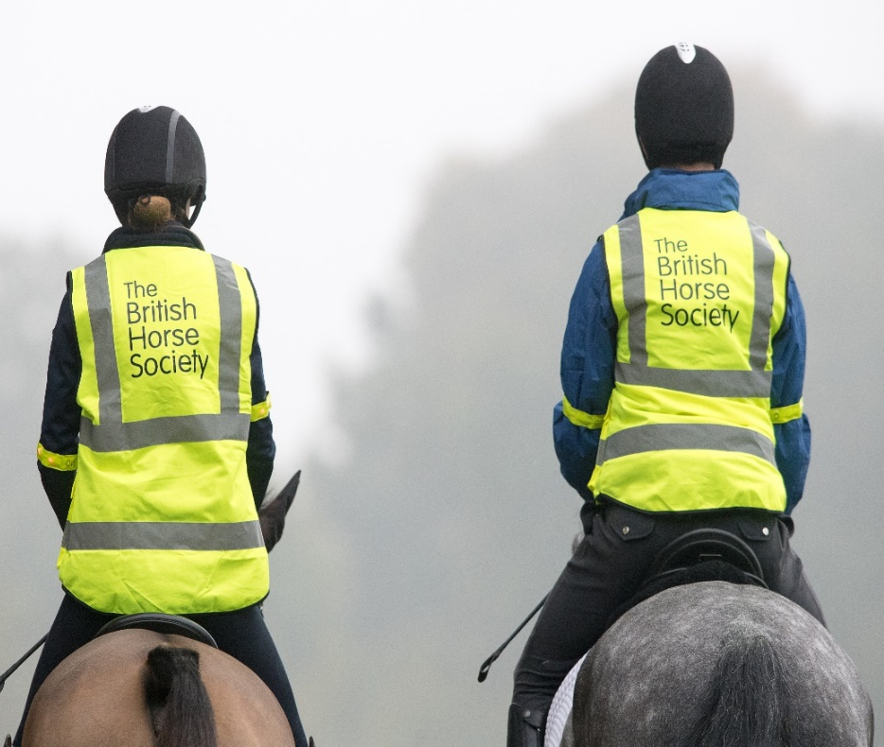
Who is it aimed at?
Every coach that intends to prepare riders for riding safely both on the road and in every other environment.
Anyone delivering the Ride Safe Silver Challenge Award.
Coaches who want to sign off the Ride Safe Silver Challenge Award
All riding school staff that take pupils out hacking or in other external environments

Slide 4
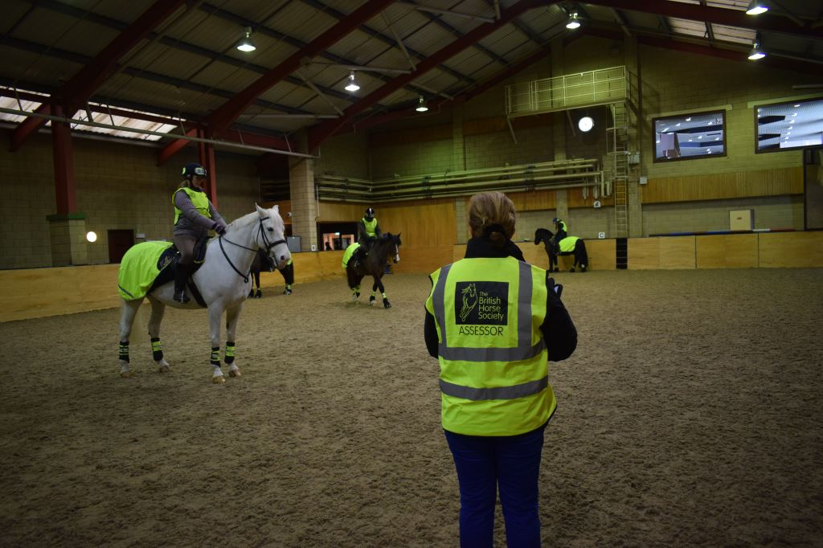
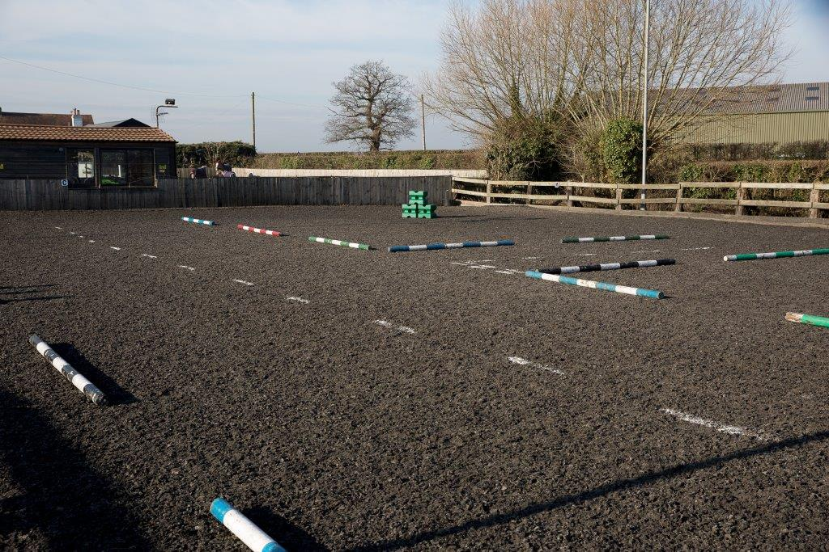
What does this training involve?
Attendance at a training session delivered by a Ride Safe Advisor – either virtually or face to face.
Personal interaction and responses required.

Slide 5
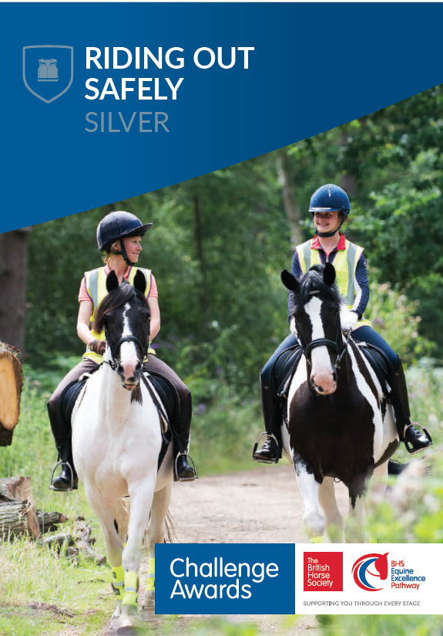
What qualification will this give me?
BHS Ride Safe Trainer Award certificate
The necessary qualifications to deliver and sign off the Ride Safe Silver Challenge Award

Slide 6
Course Structure
Introduction
Section 1 – Establishing background knowledge
Section 2 – Training riders to ride safely in a group situation
Section 3 – Developing skills in a simulated environment
Section 4 – Training riders to ride safely on the road
Summary

Slide 7
Introduction
Upon completion the coach will receive a numbered certificate with an expiry date.
You will need to do a refresher course every 3 years to ensure you are up to date with latest road regulations and we can keep you up to date with any latest road statistics.
It also gives us a chance to discuss what we have been hearing from riders and what they want to achieve within these sessions.

Slide 8
Section 1
Establishing background knowledge
Technical competence
Demonstrate a basic knowledge of learning styles.
Demonstrate an ability to adapt your coaching style to meet individual needs.
Planning
Reflective practice
Giving feedback
Evaluating
Notes:
As a riding instructor, finding out your student’s learning style will help improve your teaching methods and cater to your student’s individual needs. While it may seem a little extra work, you’re more likely to see results quicker and keep your student engaged and eager to continue improving.
Visual learners
Prefer to absorb information best through seeing. This may be by asking them to look at their road route on a plan, looking at pictures or watching a video.
Auditory learners
Tend to learn best by listening and then talking about the information. This could be listening to a recording of them riding a simulated road route and talking it over you as their coach.
Kinaesthetic learners
Learn best by doing. They tend to use all their senses and have a hands-on approach
As a Ride Safe Trainer, you need to be able to deliver to a wide range of individuals within a group. Teaching models (and a rudimentary understanding of learning styles) help to make sure there is “something for everyone” in your delivery of concepts and techniques. Your sessions need to take place in a welcoming, inclusive, and supportive environment, where all participants are engaged and feel able to participate.
Check the underlying aims and objectives of the session. Make sure you prepare to deal with changing circumstances in a session, e.g. ability, horse type, venue. Be aware of and comply with current legislation regarding children and vulnerable people. Identify learning outcomes or a clear purpose for the session, in order to help you to deliver progressive and structured sessions, with a clear direction. Brief individuals and the group appropriately. Check correct tack and clothing You should understand the impact on group motivation of a clear briefing and the group understanding the plan. The management of the whole session should then support this. Help develop a positive attitude towards Riding and Road Safety and lifelong participation within the BHS. It is important that you can demonstrate key skills and understand the roles that demonstration and instruction play in the learning process. It is also important that you understand that the participants need to practise and apply their learning.
The culture of reflective practice and striving for continual improvement is a fundamental feature in the development of all British Horse Society qualifications.
Evaluate the success of a session by assessing the appropriateness of the session aims and objectives, and the activities used to achieve them You should understand the need for, and appropriate timing of, succinct and meaningful feedback that helps your riders develop. You need to understand that different people and situations may require varied feedback methods and be able to adapt your approach accordingly. A culture of reflective practice will enable you to review and modify your sessions and delivery. A simple ‘Plan-Do-Review’ cycle should be encouraged and implemented wherever possible.
Whilst your technical competence will already have been assessed when you achieved your Ride Safe or Riding and Road Safety qualification, the Ride Safe Trainer Award qualification will assess how you make use of those skills in the facilitation of effective training sessions for others.

Slide 9
Section 2
Training groups of riders in an enclosed space
Passing Left to Left
Awareness of other horses and riders
Riding with the reins in one hand
Hand signals.
Notes:
Introducing concepts of passing left to left, never halting suddenly in front of another horse, being aware of other riders around you. Ensure you explain why. Explain the dangers of riding in a group like this, universally understood language in collecting ring (or possibly not!!), strategies to help people who struggle with left and right.
Teaching group to ride with reins in one hand. Explain why this is taught and why it is a skill a rider should have. Different methods of holding reins, what the horse needs to understand first, common issues, simple exercises.
Basic tuition on how to teach riders hand signals, how, when and where to use arm signals (how riders communicate with other road users so important to use correctly to be understood). Why saying thank you/acknowledging drivers/other road users is important.

Slide 10
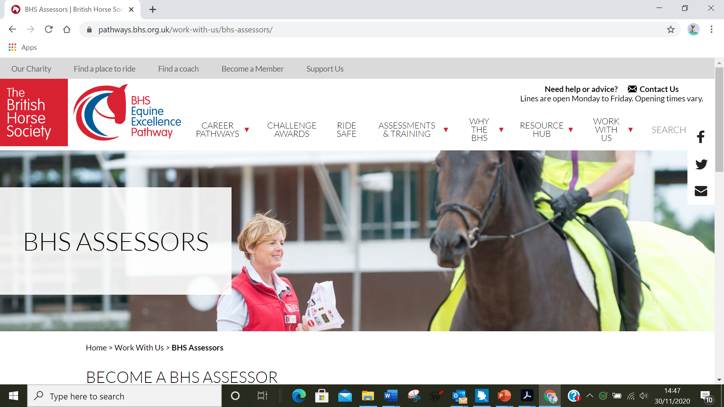
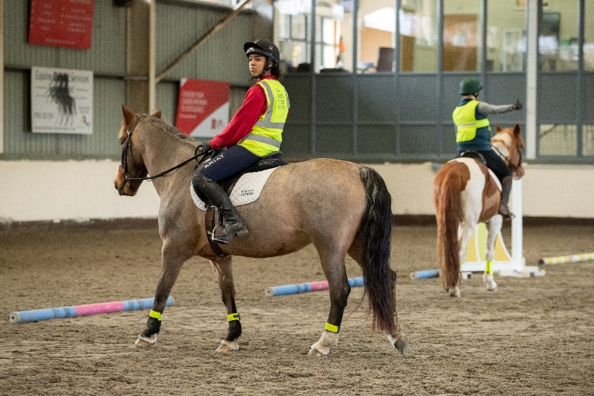
Section 3
Training riders on a simulated road route in an enclosed space.
Understand road markings, signs and symbols
Simulated route set ups
Different junctions/priorities etc
Emergency dismount procedures
Notes:
Understand road signs and symbols
Be able to set up simulated routes using poles, dressage boards, or similar. Train riders on their feet through the set-up road route, complete with hazards to pass and area suitable for dismount and lead as if on the road. Ensure the message of why we suggest riding around a hazard in a certain way is conveyed. Discuss types of junctions (non-drivers may not know) and what need to be aware of, what types of things can affect where riders position horse on road,
Different road layouts (inc flared junctions). Major and minor roads.
Tuition on carrying out an emergency dismount, when it is appropriate
Repeat above with riders mounted, including passing other horses and riders.

Slide 11
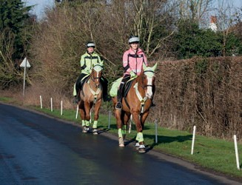
Section 4
Training riders out on the road.
Establish a suitable road route
Walk it with trainer and/or riders
Support riders riding the route
Establish protocols for riding
side by side (NOT IRELAND)
Notes:
Trainers to walk to find a suitable route that includes left, right turns with some traffic. How you can try and find a suitable place to ride at your own yard?
Trainer walking with riders mounted along route highlighting potential hazards and situations to be aware of. Maybe show different types of hazard so its not necessarily a big thing like parked car, could be children on scooters, dog in garden, wrong coloured leaf, unless you have a ‘reactive’ horse you might never consider things like this a hazard
Riding side by side and one behind another (Ireland), where appropriate and safe. and why this might be suitable

Slide 12
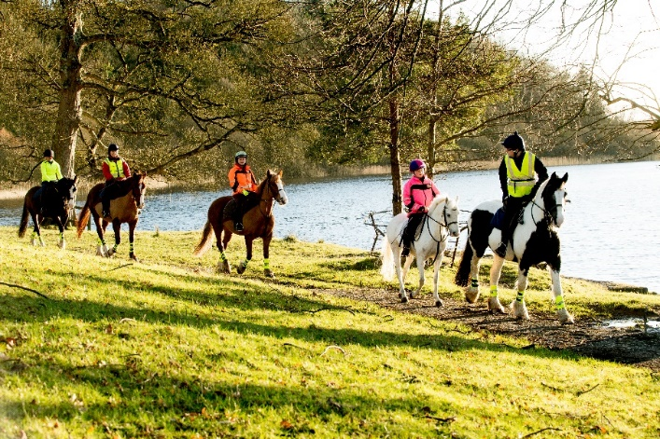
Summary
Riding safely in alternative environments
Setting up training
Promoting training
Costs and sources of funding
Value to coaches in being an APC
Notes:
Discussion about riding safely in other environments (fields/beaches/moorland/forests).
Next steps – how to set up training courses, use of Challenge Award lesson plans. Mention gold and platinum CA
Promoting training through social media/coffee mornings/at riding schools/clubs.
Costs and potential sources of funding to support training (local committees/fund raising etc)
Value to coaches of being an APC.
How to deal with confrontation, loose dogs etc? Since lockdown there has been a huge increase in the number of walkers and dogs off leads near us and it has made hacking more difficult, would it be an idea to include some tactics to deal politely with this?
2026 save your route campaign

Slide 13
Other Bits
How bronze, gold and platinum challenges fit in
Resources for Advisors, coaches and candidates
  Trainer’s guide
  Challenge Booklet
  Syllabus
  Training day programme

Slide 14
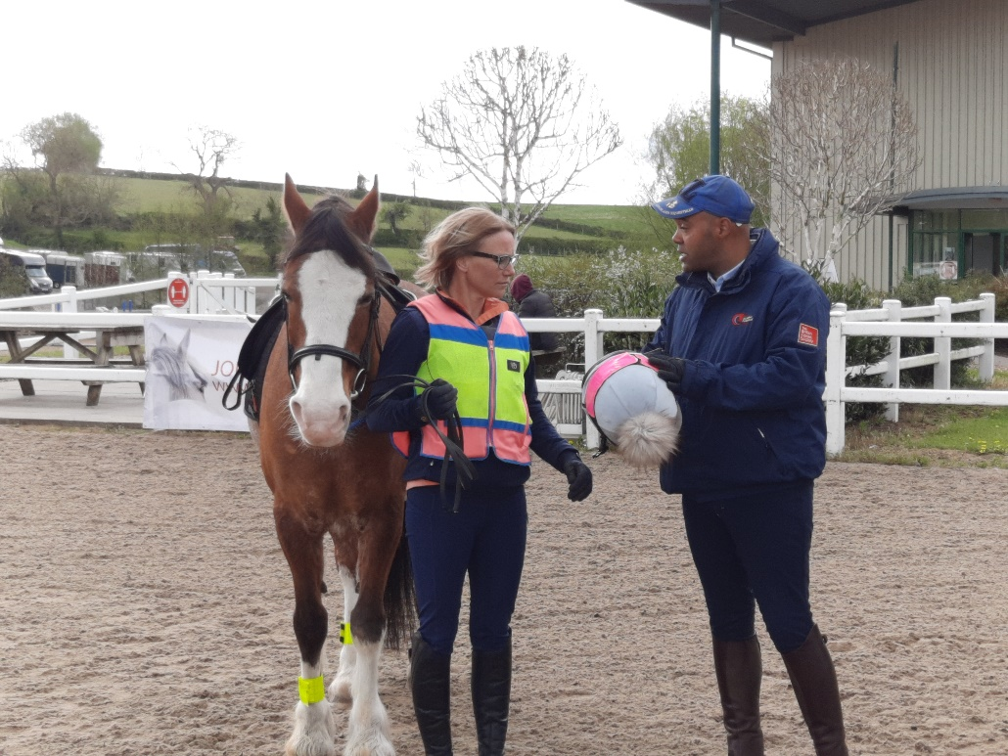
Where can I find out more?
Contact the BHS Education Team on
024 76 840508
Email us on education@bhs.org.uk
Look on our website www.bhs.org.uk
Notes:
Dress Guidance
Ride Safe is a recreational award and as such, the dress guidelines are more relaxed than at a Stages assessment. Appropriate riding wear should be worn (jodphurs, gloves, riding boots). Riding hats (and body protectors if worn) should be of current accepted standards. High Viz is crucial.
The current standards can be found on our website: www.pathways.bhs.org.uk/resource-hub/forms-and-guidance/dress-guidance

