Slide 1
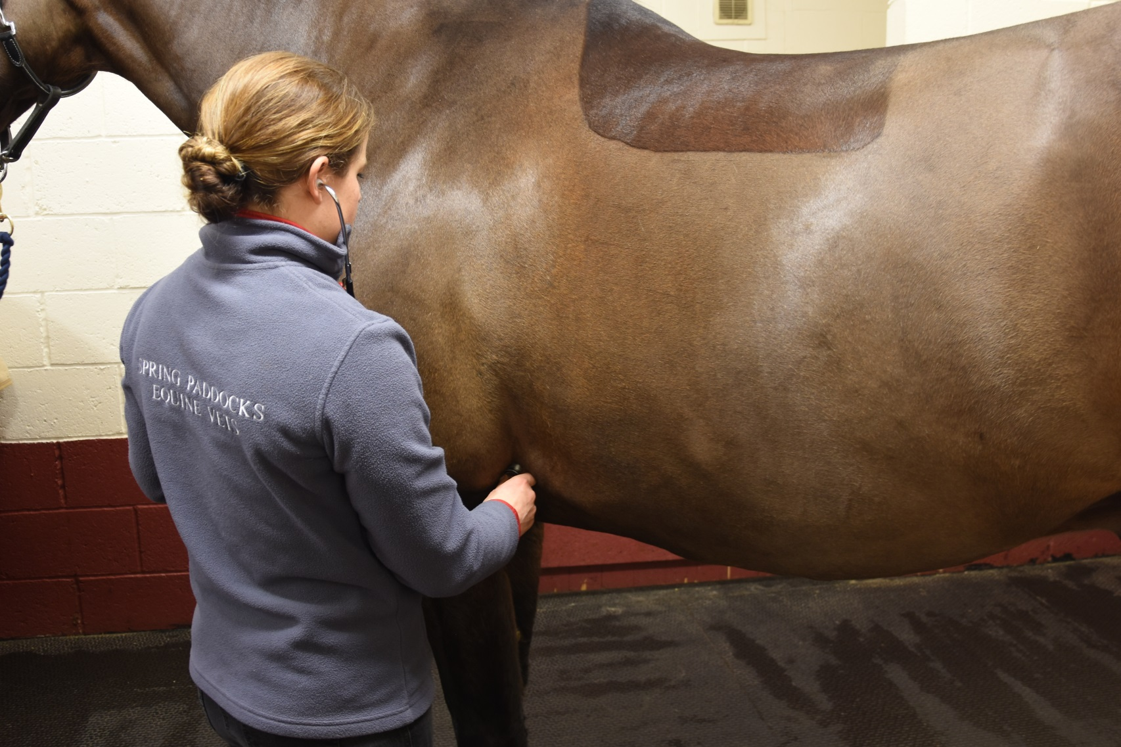
Horse Knowledge Signs of health
Notes:
This section introduces signs of health and illness starting with the basic signs of health to look for during daily checks.
It then touches on preventative methods such as vaccination and the importance of disease prevention (bio-security)

Slide 2
Signs of good health
EYES
Bright
Clear
Open
NOSTRILS
Clear
Relaxed
APPETITE
Eating and drinking normal amount
Chewing evenly
Not dropping food
Notes:
Signs of health
In small groups discuss what signs of health they would look for in the horse
Starting with the headings : eyes, nostrils, appetite which are in the participants booklets
Create a master list and discuss each point raised
Participants to fill in booklet with signs of health

Slide 3
Signs of good health
Body
Ideal weight
Shiny coat
No lumps, swellings, heat
Legs
Standing evenly on all four legs
No heat, lumps, bumps, swellings
Moving normally
General appearance
Alert and interested
Muscles relaxed
Droppings
Firm, break when hit ground
Normal amount
Notes:
Discuss in small groups the headings: Body, Legs, General appearance, Droppings
Create a master list on flip chart/white board and discuss each point raised
Participants to write notes in their booklets

Slide 4
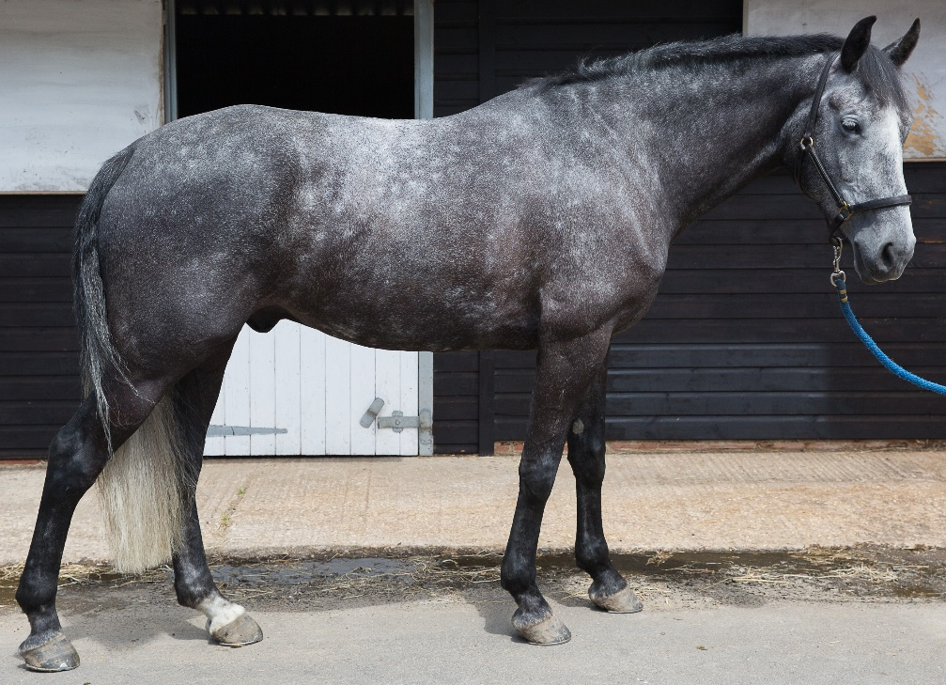
Signs of ill health
Eyes:
Dull
Cloudy
Partially closed
Nostrils:
Discharge
Blood
Flared
Appetite:
Not eating or drinking
Eating or drinking less
Very firm or loose droppings
Body:
Underweight
Overweight
Tight skin
Dull coat
Legs:
Limping
Not able to stand evenly when asked
Heat
Swellings
Cuts
General appearance
Quiet/withdrawn
Lack of interest
Tight muscles

Slide 5
Preventing the spread of disease
Equine flu
Highly contagious
Can be transferred from horse to horse
Signs include: coughing, nasal discharge and high temperature
Vaccination greatly reduces the symptoms
Tetanus
Can be fatal
Horses more susceptible because of the environment they live in
Vaccination offers complete protection
Notes:
Prevention is better than cure… as a group discuss why – include humans as well as animals!
Ask the group if they are aware of any vaccinations available for horses?
Briefly discuss Equine Flu symptoms. Include the recent outbreak and how it has affected the equine world
Briefly discuss tetanus symptoms – can affect horses and humans!
Discuss the initial vaccination programme for flu and tetanus and the boosters required after.
If possible have a look at some vaccination records and work out the initial course and which are flu and flu/tetanus

Slide 6
Disease prevention
Notes:
Ask the group what they understand by the term Disease prevention
Ask the group if they can think of any issues with people touching horses around a yard, sharing equipment between horses, letting unknown horses touch each other at competitions/events, bringing new horses onto a yard?
Can they think of any biosecurity rules in place at a yard
Discuss each of the points on the infographic and how they can help to prevent the spread of disease

Slide 7
Quick quiz
List four signs of good and ill health
What two illnesses can be vaccinated against in the UK?
How often are booster vaccinations required for each of these illnesses?
Why is it not a good idea to share brushes between horses on a yard?
List two things you can do to prevent the spread of disease between horses on the yard
Notes:
This quiz is very informal and is not designed to be a test. Answers can be written or verbal and space is available for participants to write answers in their booklets.
Suggested answers:
Any four for each from session discussions
Equine flu and Tetanus
Flu – every 6 months, Tetanus – every 2 years
Disease can be passed between horses
Any 2 suggestions from discussions in session or the disease prevention poster

