Slide 1
Field Care
Notes:
This section covers the basic fields checks and routine field care to ensure the field is suitable and safe to use.

Slide 2
What would your field check include:
Boundary
Water supply
Removing droppings
Poisonous plants
Rubbish
Holes
Notes:
Ask the group if they are aware of how much grazing is recommended for a horse. What could happen if there is not enough grazing/ too much grazing?
Ask the group to think about what kind of checks they would carry out daily/weekly/monthly on a field used for grazing horses and create a list.
Discuss what to look for in each check

Slide 3
Boundary Fencing
Necessity to keep the horses in the field!
Various types:
Post and Rail
Can be plastic or wooden
Long lasting if looked after
Can withstand horses leaning/scratching on it
Notes:
Split the group into smaller groups and allocate each a fencing type or ask to come up with their own list. Ask them to consider the pros and cons of each type
Feedback to the rest of the group
There is space in the booklets for participants to write notes.

Slide 4
Electric fencing
Suitable as an inside boundary fence but should not be the only fence
Can be used with permanent posts
Can be used with moveable post to allow the field to be moved around
Strands need to be visible to horses
Can be powered by mains or battery packs
Notes:
Discuss

Slide 5
Hedges
Check that trees and bushes growing aren’t poisonous to horses
It needs to be thick enough horses can’t squeeze through gaps
Can be used with electric tape in front as solid boundary
Notes:
Discuss

Slide 6
Barbed wire and stock fencing
Both of these types of fencing are unsuitable for horses
Barbed wire will injure the horse if he rubs on it
Stock fencing squares tend to be the same size as a hoof so there is potential for the horse to get his hoof or shoe stuck in it
Notes:
Discuss

Slide 7
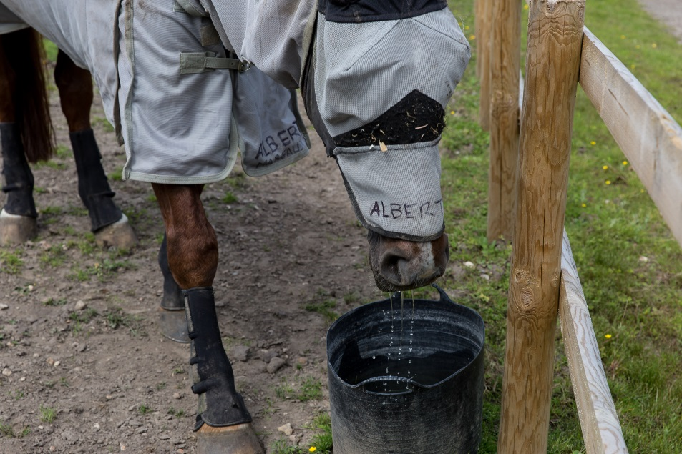
Water supply
Notes:
Methods of supplying water has been covered in previous sessions – recap with group ways of providing water in field
Ask what checks they would carry out for each method of watering suggested

Slide 8
Picking up droppings
Reasons:
Horses don’t tend to eat grass near droppings
‘Lawns and roughs’
Parasite control
Notes:
Ask the group why they think you might need to remove droppings from the field?
Discuss briefly parasite control – overview of the lifecycle and why removing droppings breaks this cycle
Can discuss methods of removing droppings – wheel barrow and skip, machine etc

Slide 9
Parasites
Worms that live within horse’s body
Can cause irreparable damage to internal organs
Methods of controlling
Notes:
Briefly discuss what parasites are and how they can affect the horse
Include a basic overview of worm lifecycle and why removing droppings helps to control them
Discuss other methods of testing for worms

Slide 10
Any other checks?
Rubbish that has blown in or been dropped
Rabbit holes that a horse could put his foot down
Fallen or overhanging branches
Gate fastens securely
Anything else that could potentially injure a horse
Notes:
As a group ask for ideas of any other checks they might want to carry out to ensure the field is safe and suitable
Make a list to ad to the ones on the slide

Slide 11
Poisonous Plants
Check regularly for signs of poisonous plants growing
Can grow at any time of the year depending on species
Wear protective gloves
Dig up from roots where possible to prevent regrowth
Notes:
This section is an introduction to recognising common plants that are poisonous to horses
Remind the group that some are also toxic to humans so care must be taken when removing them
A selection of plants and trees are shown on the following slides, the same pictures are in the booklet with space to write the name underneath. Show the group each picture and ask if they recognise it.

Slide 12
RAGWORT
In its first year it appears as green leaves growing in a rosette shape
In the second year it grows long stems with distinctive yellow flowers
Bitter taste so horses don’t tend to eat it unless grazing is very sparse
When dried it becomes more palatable
Remove by digging out from the roots
Notes:
Ragwort
Describe what to look for – rosette stage and the yellow flowers
If possible look at the ragwort toolkit

Slide 13
Foxglove
Also known as digitalis
Very poisonous to horses and humans
Tall tubular stem with bell-shaped flowers
Commonly seen with purple flowers but can have other colours such as white or yellow
Found in moorlands, woodland and hedgerows

Slide 14
Deadly Nightshade
Bell-shaped purple flowers
Berries – colour ranges from green to black when ripe
Oval-shaped leaves with pointed ends
Likes to grow in woodlands, field margins and hedgerows
Not palatable to horses but may be eaten by accident if baled in hay

Slide 15
Yew
Highly poisonous to horses
Causes death almost instantly if eaten even in small amounts
Evergreen tree
Soft flat needle shaped leaves that are dark green on the surface and paler underneath

Slide 16
Acorns
Acorns grow on oak trees
The acorns, buds, leaves and blossom of an oak tree can all be toxic to horses
Oak tree leaves have lobes making them very recognisable
Acorns can be eaten when they fall off and can be toxic in large quantities
Trees should be fenced off
Oak trees don’t produce acorns every year

Slide 17
Laburnum
Highly poisonous tree
It has distinctive yellow flowers that hang in long clusters
Green leaves grow in threes
It has pea-like pods which contain black seeds
All parts of the tree are poisonous

Slide 18
Sycamore Seeds
Sycamore tree is easily recognisable by its ‘helicopter’ seeds
These can travel large distances in the wind
When seeds or tree saplings are eaten they can cause Seasonal Atypical Myopathy which affects the horses muscles and can be fatal

Slide 19
Quick quiz
List three field checks that you would carry out daily
List two types of fencing suitable for horses
Why is barbed wire not suitable fencing for horses?
Name and describe two plants or trees that are poisonous to horses
Notes:
This quiz is very informal and is not designed to be a test. Answers can be written or verbal and there is space in the booklet for participants to write their answers.
Suggested answers:
Any 3 acceptable from the list in the booklet or discussed in session
Any 2 acceptable from the booklet or covered in the session
It can cut them if they lean on it, rip rugs, or any other acceptable answer
And 2 from the list in the booklet or covered in the session.

