Slide 1
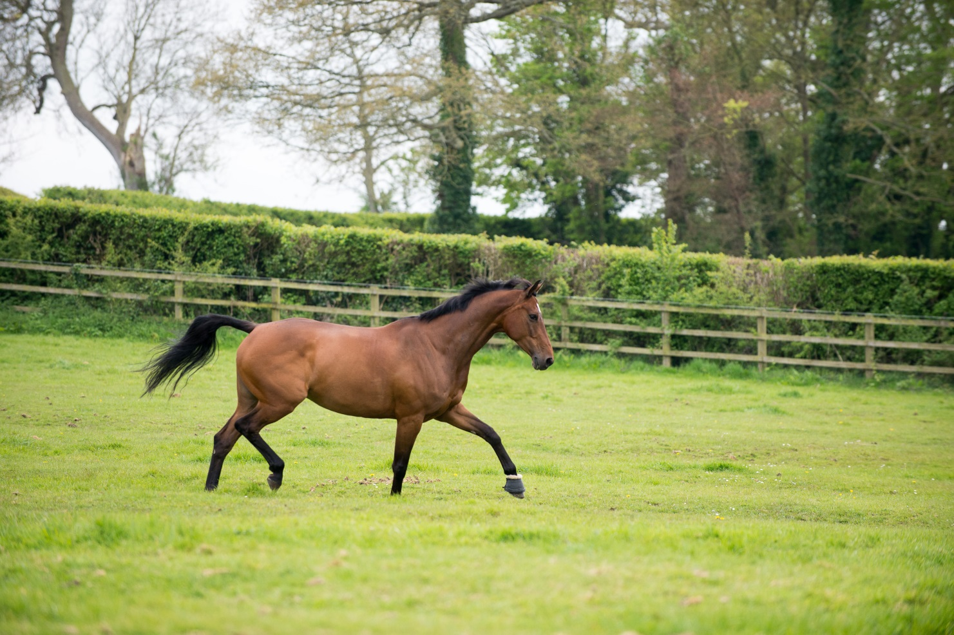
Horse Care Horse Welfare
Notes:
Horse Welfare covers the basic needs of the horse
These can be applied to all animals not just horses

Slide 2
What are the basic needs of any animal?
1. Shelter
2. Company
3. Freedom to exhibit normal behaviour
4. Food and Water
5. Be free from pain, suffering, injury and disease
Notes:
Split the group up into smaller groups and ask them to discuss what they think are the basic needs for any animals and make a list.
Each group feedback to the main group
Create a master list and compare it to the guidelines on the slide

Slide 3
Shelter
From the elements
trees
bushes
purpose built shelter
stable
rug
high wall/side building
Notes:
Discuss each item on the list – what does it mean for horses and suggest ways it can be provided

Slide 4
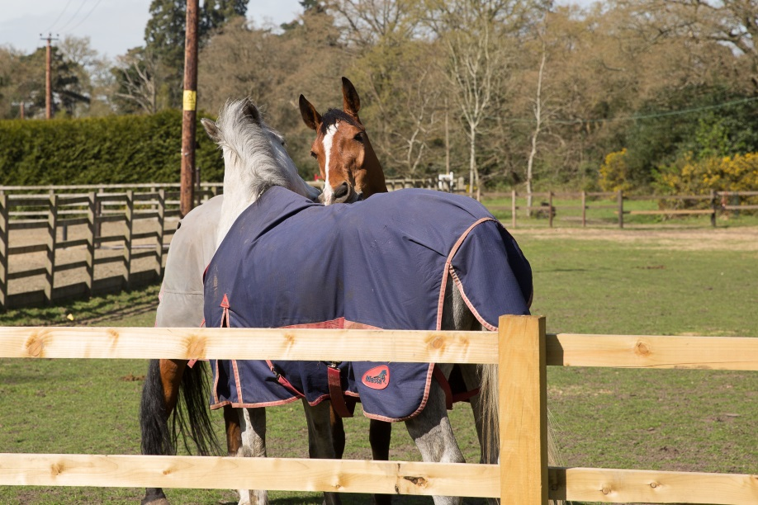
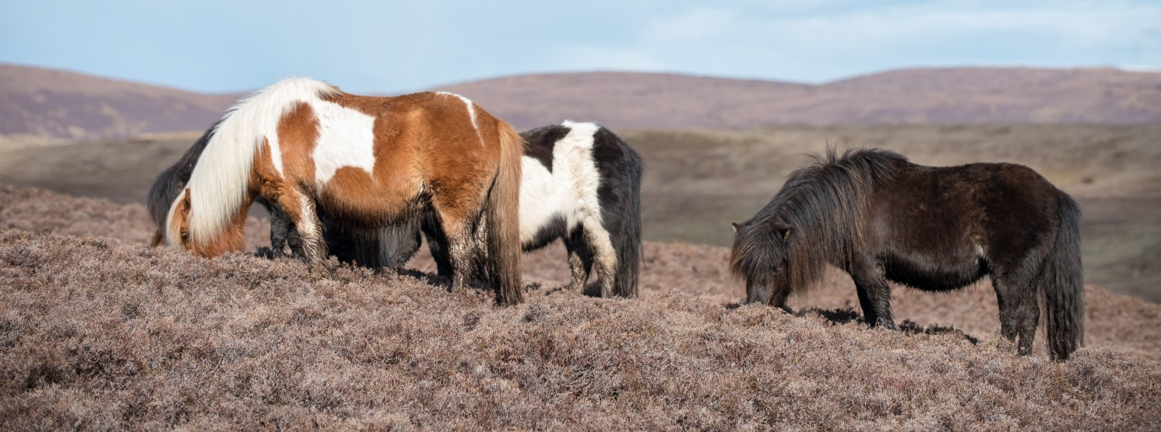
Company
Evolved to live in herds
with other horses or ponies
Notes:
Discuss what animals make suitable company for horses.
Discuss what can happen if a horse doesn’t have suitable company?

Slide 5
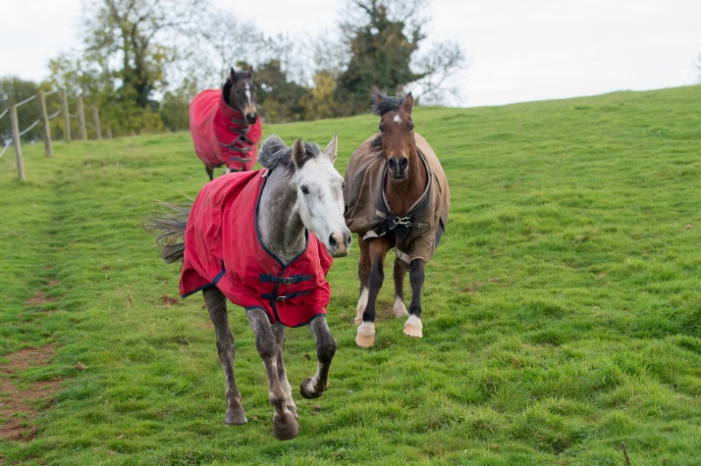
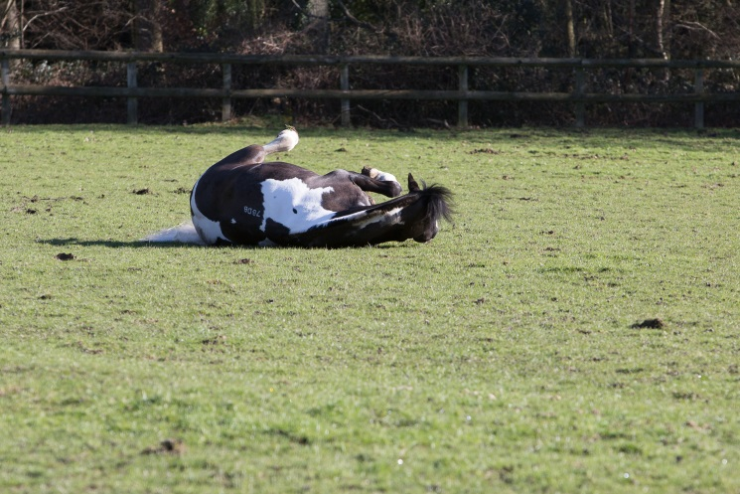
Freedom to exhibit normal behaviour
What does this mean?
Let the horse be a horse!
Turnout allows them to choose what they do and when they do it
Notes:
Discuss what is meant by normal behaviour patterns?
Discuss what can happen if horses are not able to do this? What type of situation may mean a horse cannot do this – box rest, long periods of no turn out (weather, ground, yard restrictions)

Slide 6
Food and Water
Horse is a herbivore
Digestive system evolved for a high fibre diet
Feeding wrong type of feed cause digestive upset
Water is required for all bodily functions and processes
Horses can be fussy drinkers
Notes:
Discuss what a herbivore is
Discuss what the horse is designed to eat – grass in the field/hay or haylage in stable. More about feeding is covered after this section
Discuss what can happen if the horse is fed the wrong type of diet
The importance of providing free access to fresh, clean water (80% of the horse is made up of water)

Slide 7
Free from pain, suffering, injury and disease
Recognising normal behaviour
Recognising behaviour changes
Routine health care (preventative procedures)
Industry professionals who can help e.g.
Vet
APC
BHS Welfare advisor
Notes:
Discuss normal behaviour patterns for horse – eating/drinking etc
What can make these behaviours change?
Discuss what kind of routine health care is required for horses – vaccinations, worming, farriery, dentistry, saddler…..
Discuss who horse owners can turn to for help or advice if they need to?

Slide 8
Quick Quiz
List the 5 welfare needs of the horse
Give a reason why you need to meet these needs
List a way you can ensure you meet each one of these needs
Notes:
This quiz is very informal and is not designed to be a test. Answers can be written or verbal and there is space for the participants to write answers in their booklet.
Suggested answers:
Company, shelter, food and water, free from pain, disease and suffering, exercise normal behaviour
Any acceptable reason covered in the booklet or the session
Any acceptable method/suggestion covered in booklet or session

