Slide 1
Horse Knowledge
Part Two
Notes:
Add coach name to the text box
The slides are grouped by topic and can be delivered in any order
There are optional notes giving ideas for session plans or activities to go along with each presentation
There are optional handouts available to download from the BHS Cloud

Slide 2
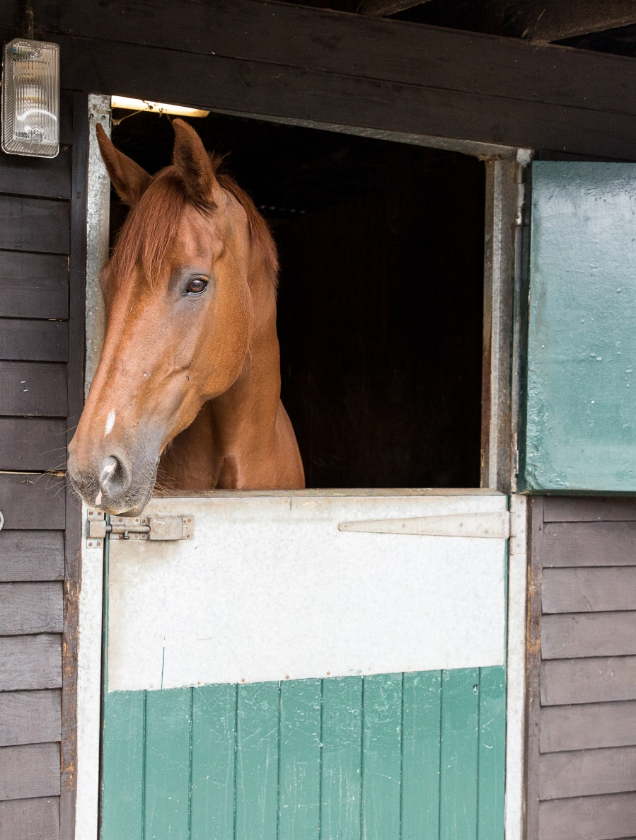
Introduction
Welcome
Housekeeping
Structure of course
Notes:
Welcome group and explain the structure of the course. The content covered is on the next slide
Any housekeeping such as location of fire exits, toilets, tea/coffee provisions

Slide 3
Basic Horse Knowledge part two
Content
Horse behaviour
Passports and microchips
Signs of good health
Disease prevention
Feeding
Field checks
Poisonous plants
Parts of the saddle and bridle
Notes:
Outline the main topics covered within the course. These are broken down further at the start of each section.
The slides have been grouped in topics that follow the layout of the booklet but can be delivered in any order.

Slide 4
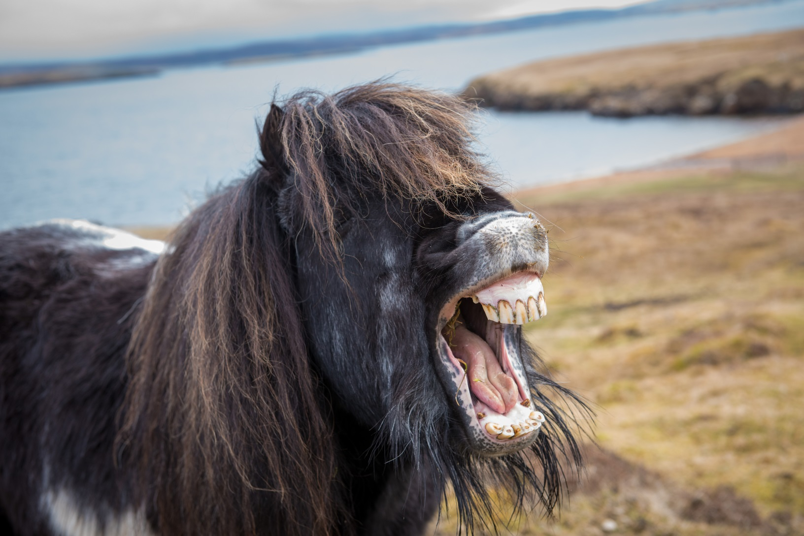
Horse Knowledge
Horse Behaviour
Notes:
This section introduces how to recognise facial expressions and reactions of the horse. Link it back to yard safety from part one

Slide 5
Body language
Why is it important to understand horse’s body language and facial expressions?
Notes:
Discuss with the group why it is important to know about horse behaviour
Discuss how horse’s communicate with each other and with us. Can the group give any examples of communication behaviour they have seen?
Discuss how the horse communicates with us, ask the group for their examples

Slide 6
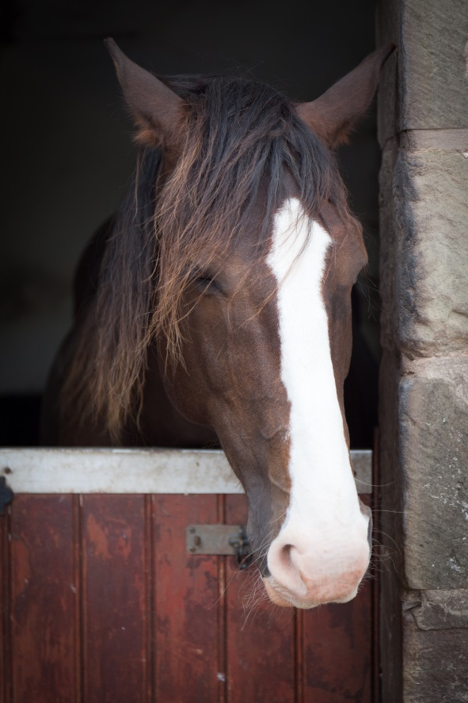
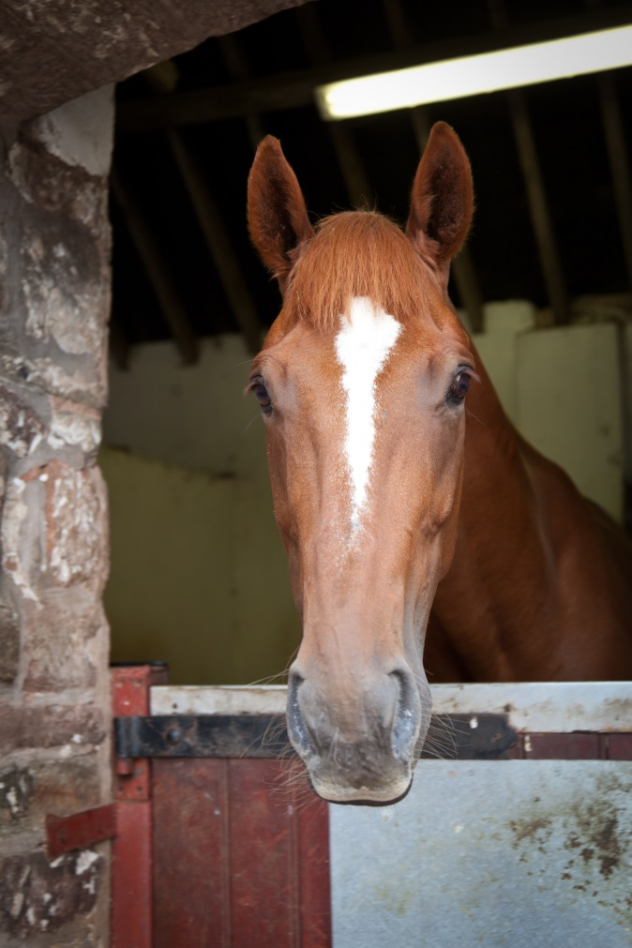
Ears!
Notes:
As a group describe some facial expressions that indicate the horse is: happy, alert, unhappy,
Discuss the two horses in the pictures – what do the group think they are showing?
Either as a group or divided into smaller groups discuss the horses shown on the following slides
(Can also use these slides as a revision of colours and markings from part one)
Consider adding other relevant pictures or videos clips to this section

Slide 7
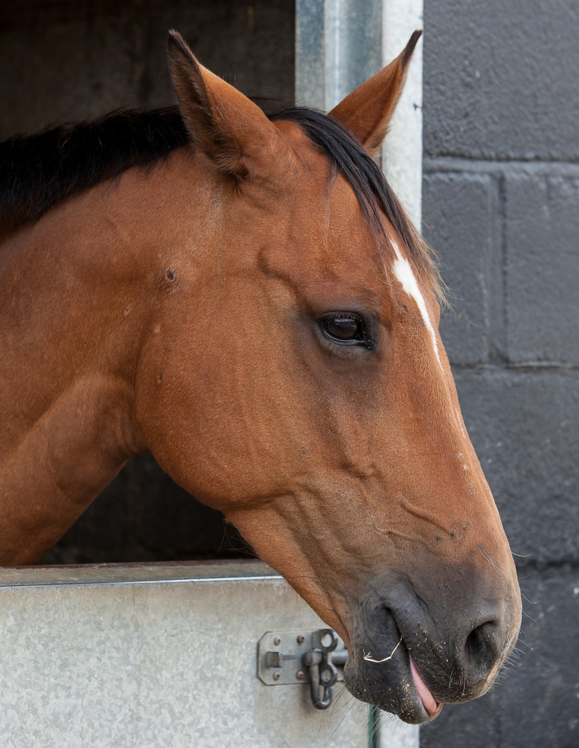
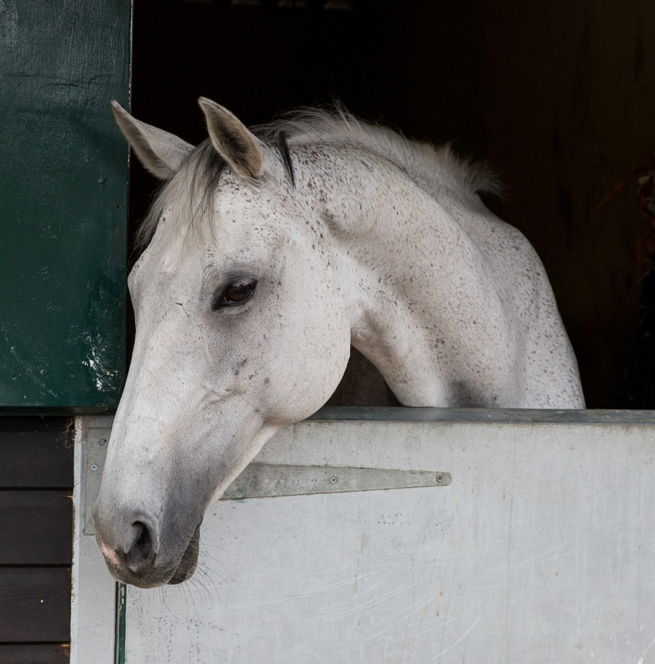
Notes:
Discuss each horse in the picture (these pictures are the same as the booklet)
Discuss what the group can see in terms of body language as well as the facial expression e.g. relaxed muscles, wide eye, relaxed nostrils, stance. What kind of reaction would you expect if you approached each horse?

Slide 8
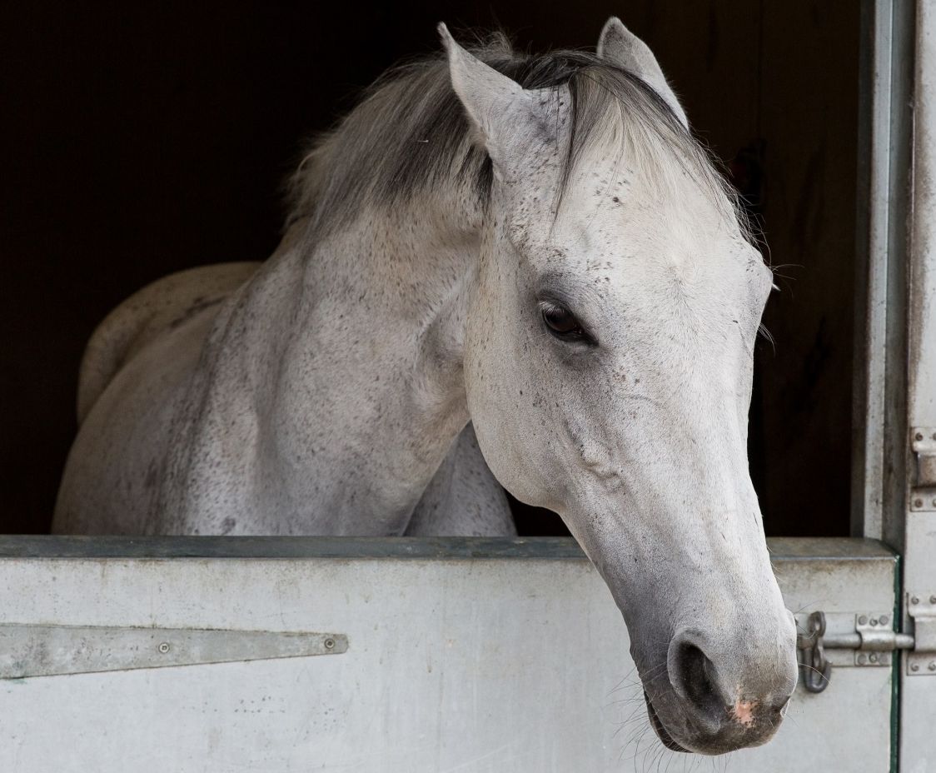
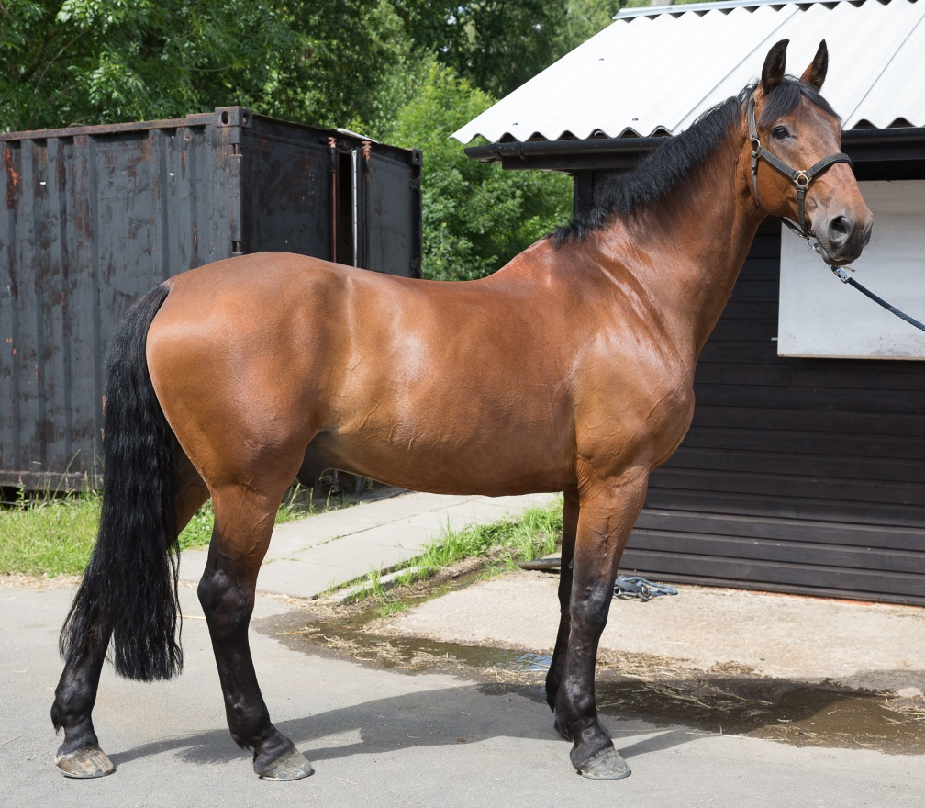

Slide 9
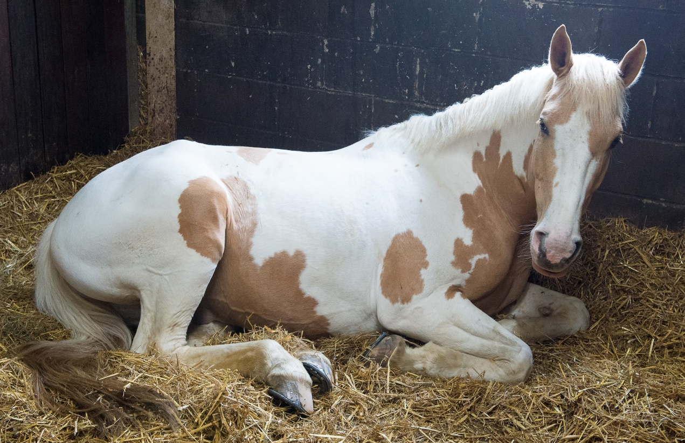
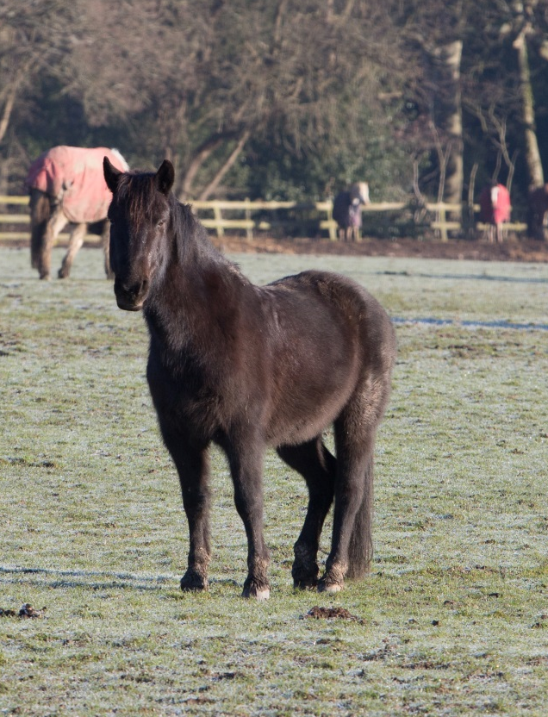
Notes:
Ask the group if they have seen a horse sleeping – lying down or standing up?
Discuss how horses sleep/doze
Is it normal to rest one leg more than other or switch from leg to leg?

Slide 10
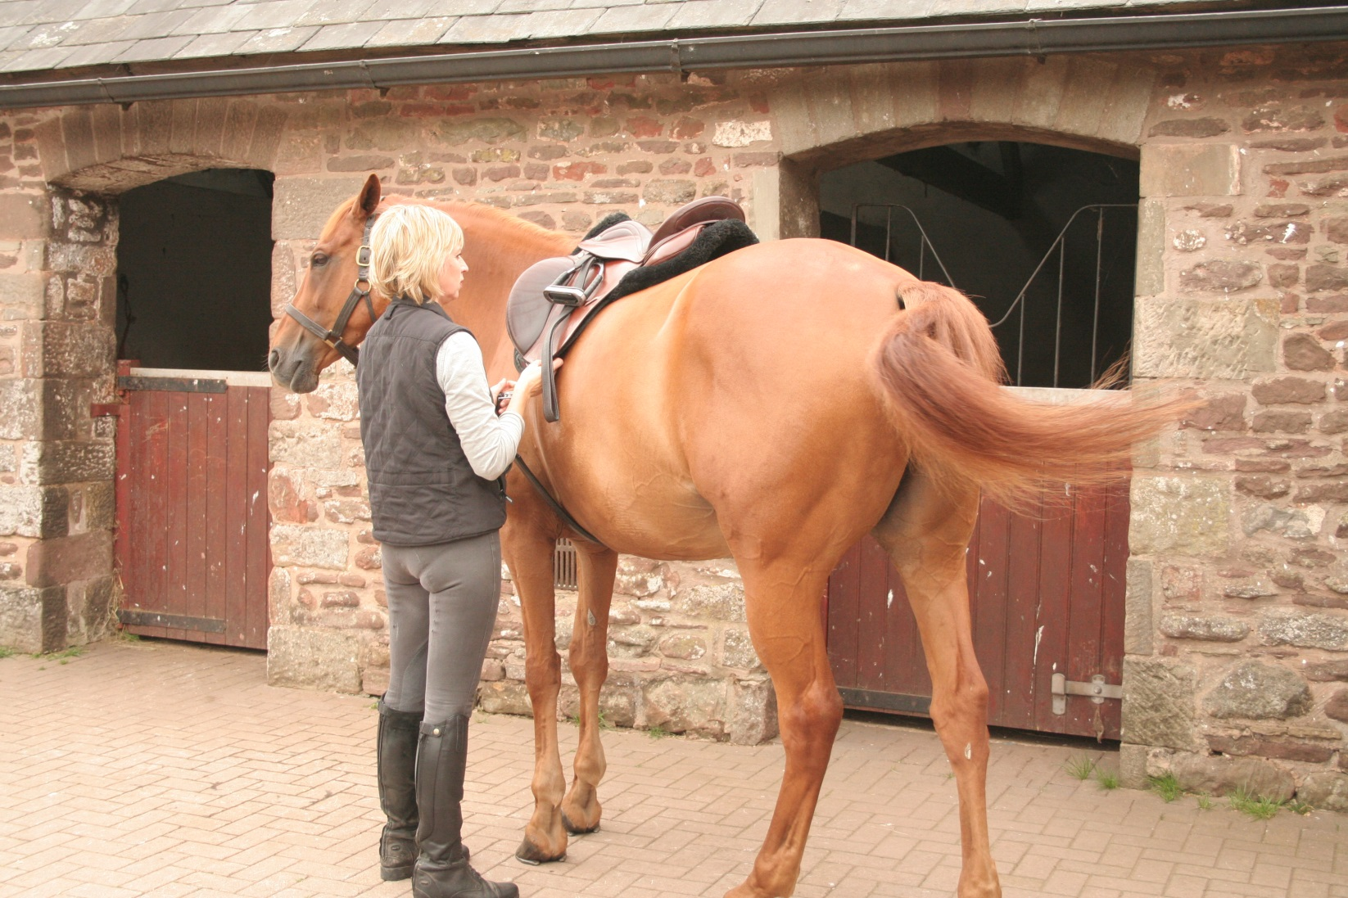
Tail Swishing
Notes:
Ask the group what other signs the horse may display to indicate how it is feeling?
Ask the group if they think paying attention to what the horse is doing with his tail is important?
What does the horse use his tail for?
What is the horse on the slide doing? Can they identify all the signs of discomfort – ears, face, tail, leg position
Discuss safe positioning while working round horse e.g. tacking up or grooming and the potential outcome if you don’t respond to what the horse is telling you.

Slide 11
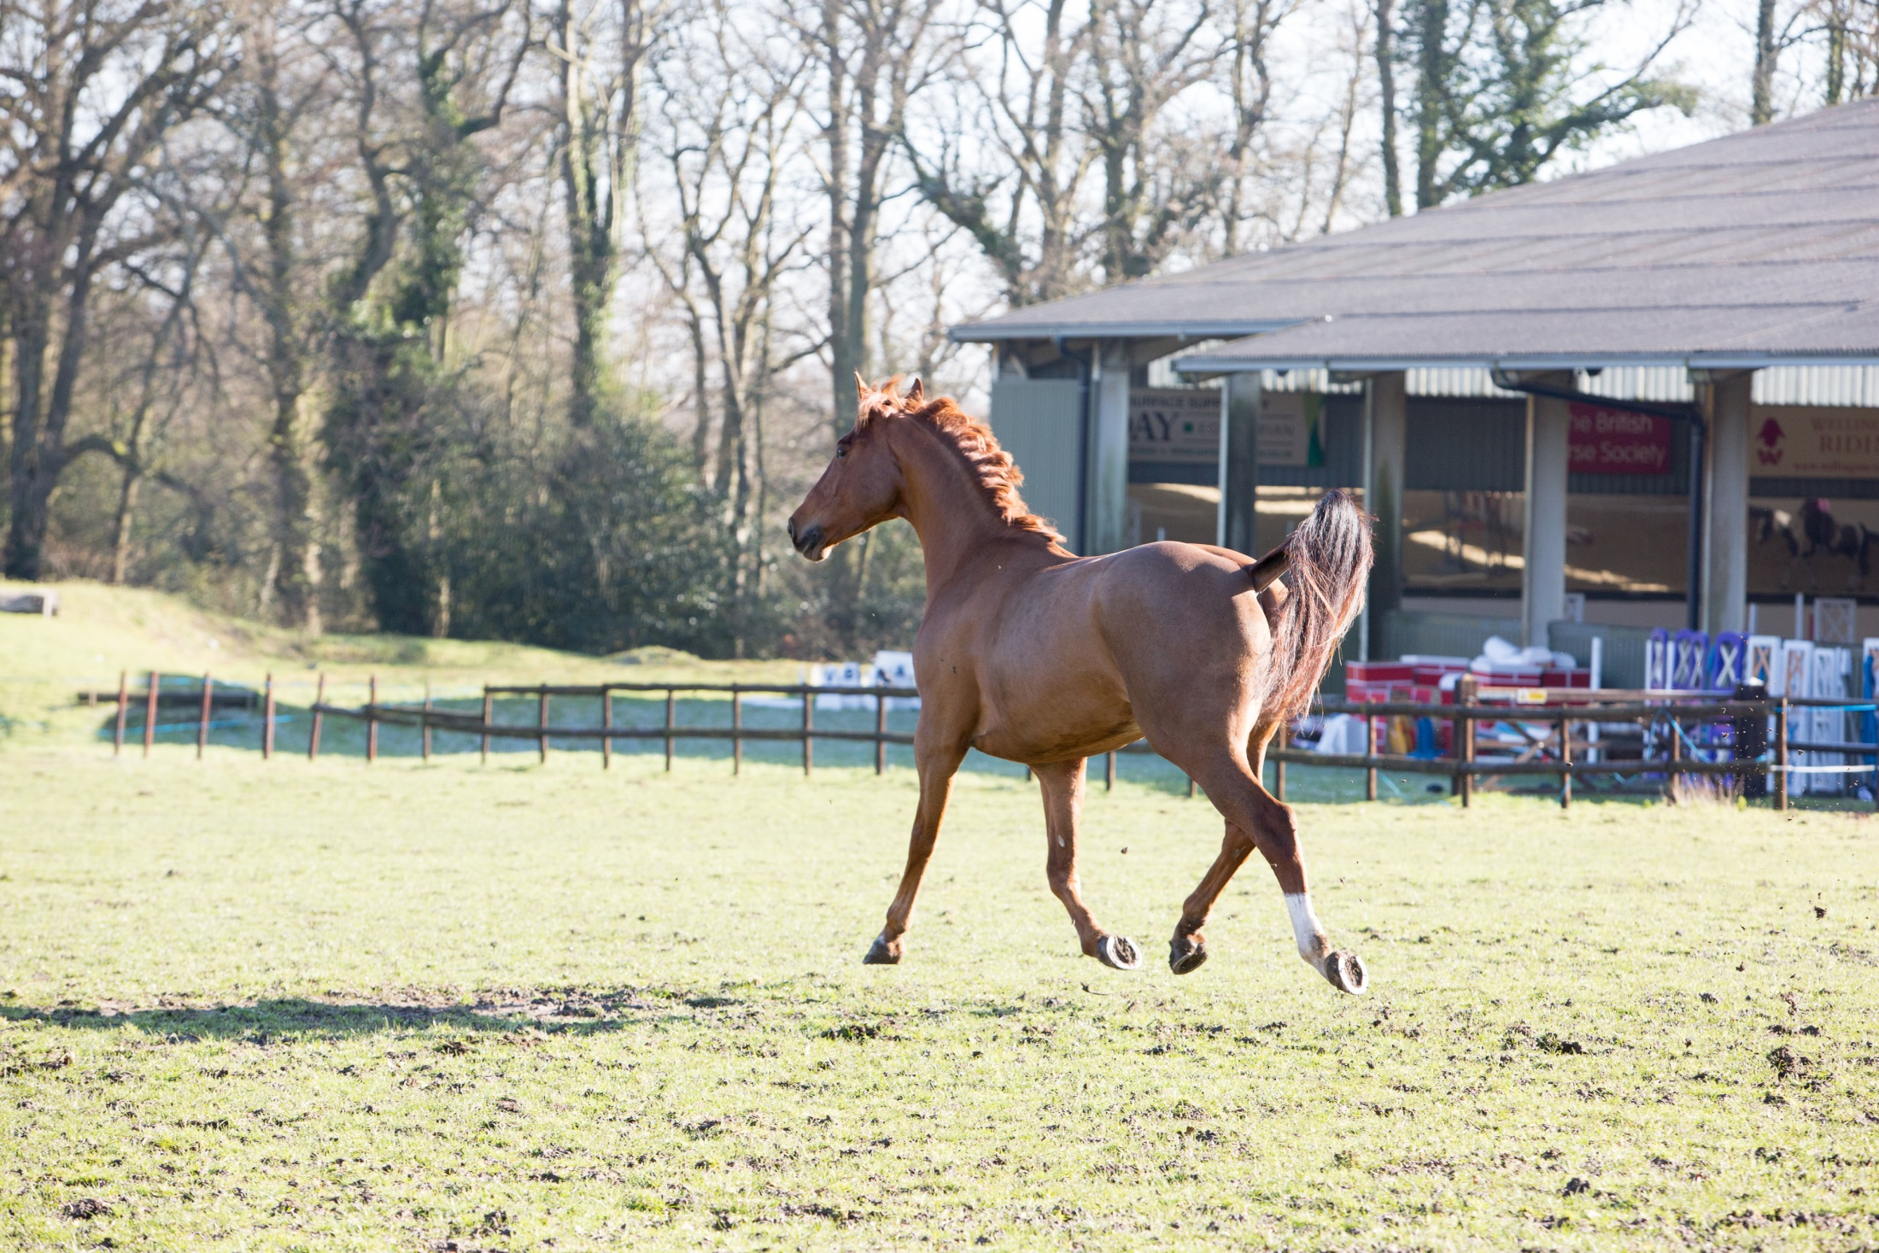
Notes:
How to tell if the horse is excited! Ask the group to suggest potential signs – describe the horse on the slide, why might he be acting like this
Do the group know of any breeds of horse that carry their tail high naturally?

Slide 12
Quick Quiz
Why is it important to recognise horse facial expressions and body language?
How might a horse that is protective of his stable react when you approach?
What might a sensitive horse do when you groom him?
What behaviour would tell you your horse is relaxed
What behaviour might a horse that is excited display?
Notes:
This quiz is very informal and is not designed to be a test. Answers can be written or verbal and there is space for the participants to write answers in their booklet.
Suggested answers:
To recognise how the horse is feeling and may react to you or the situation
He might put his ears back, pull a face, wrinkle his nostrils, stretch head and neck out towards you or any other description discussed within the sessions
He might swish his tail, put his ears back, stamp a foot, kick out, move away
Such as: Head down, droopy lip, ears relaxed, resting hind leg
Such as: Head and neck raised, ears pricked, tail carried

